Slide 1
How Bad Has COVID-19 Been for the Stock Market?
By: Jacob Avchen, Jacob Hollander, and Salvatore Russo

Slide 2
Question 1:
Which Markets Have Been Most Negatively
Impacted by the Spread of COVID-19?
We examine a sampling of companies from different industries to determine which ones are being hit the hardest.
We broke our sample of 35 companies into 7 categories with 5 companies in each category to compare to each other. We also took data from 5 ETFs to get rough approximations of entire industries, and the DOW Jones Industrial Average and S&P 500 Indexes.
The following slides will show the hardest hit or most interesting industries to look at.

Slide 3
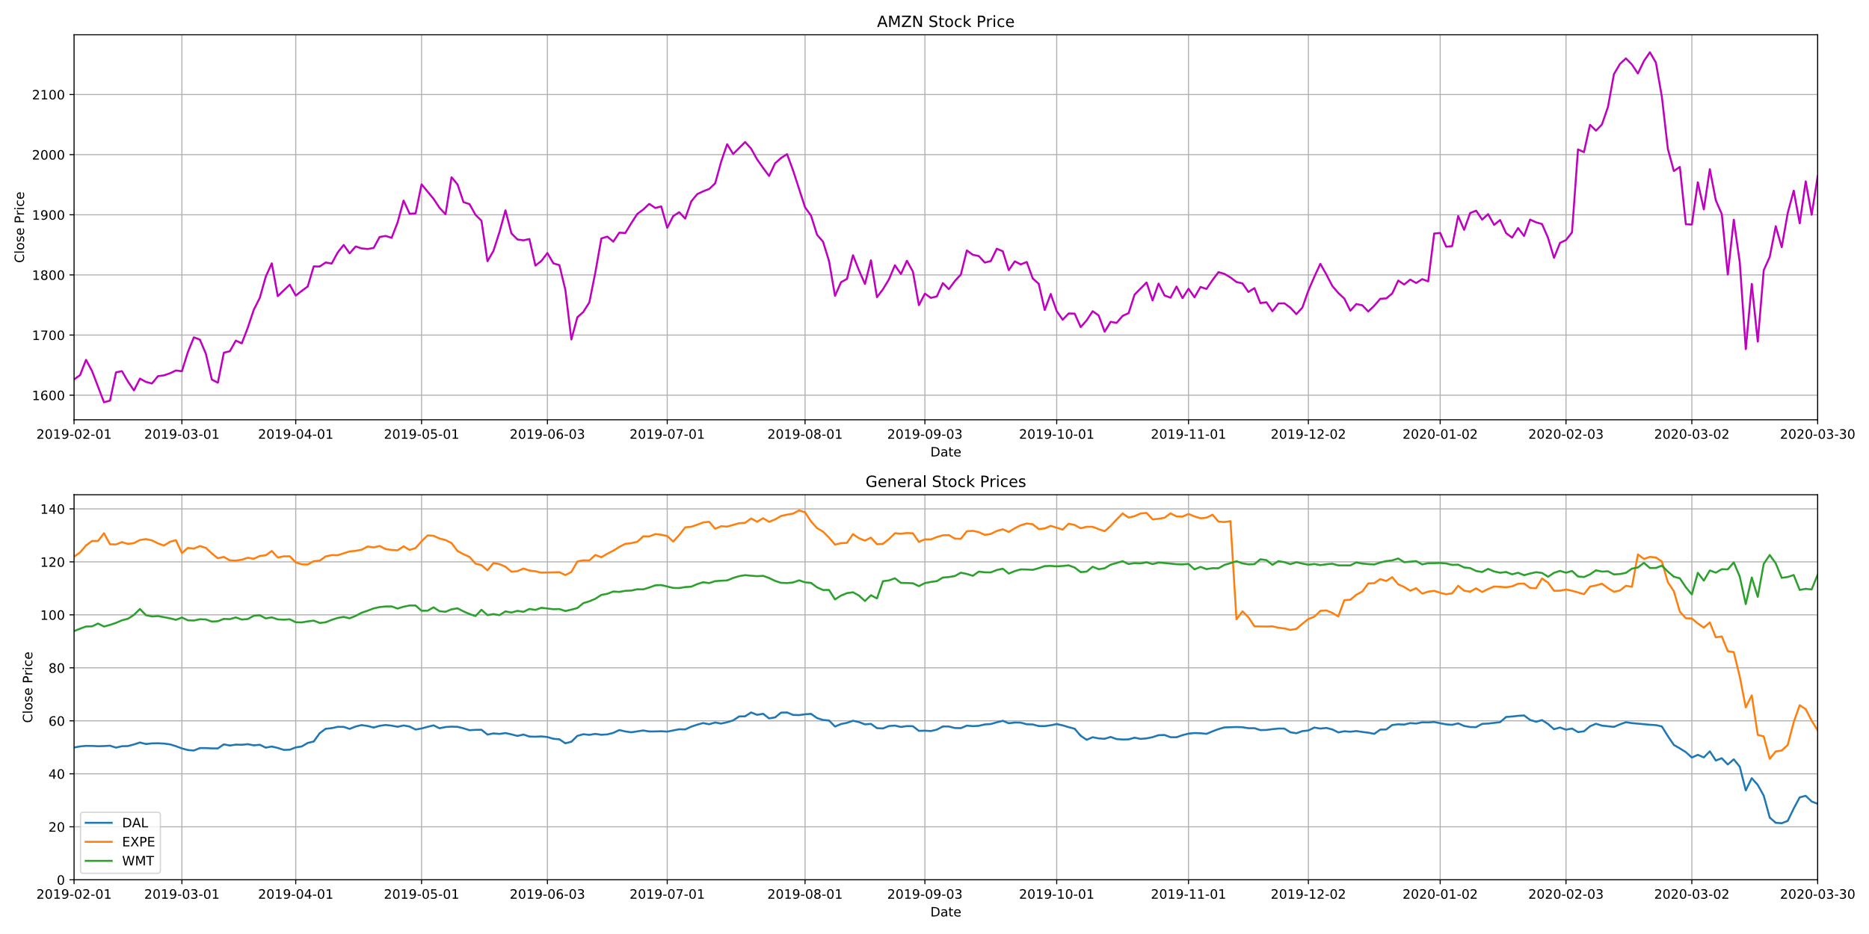
General Stocks

Slide 4
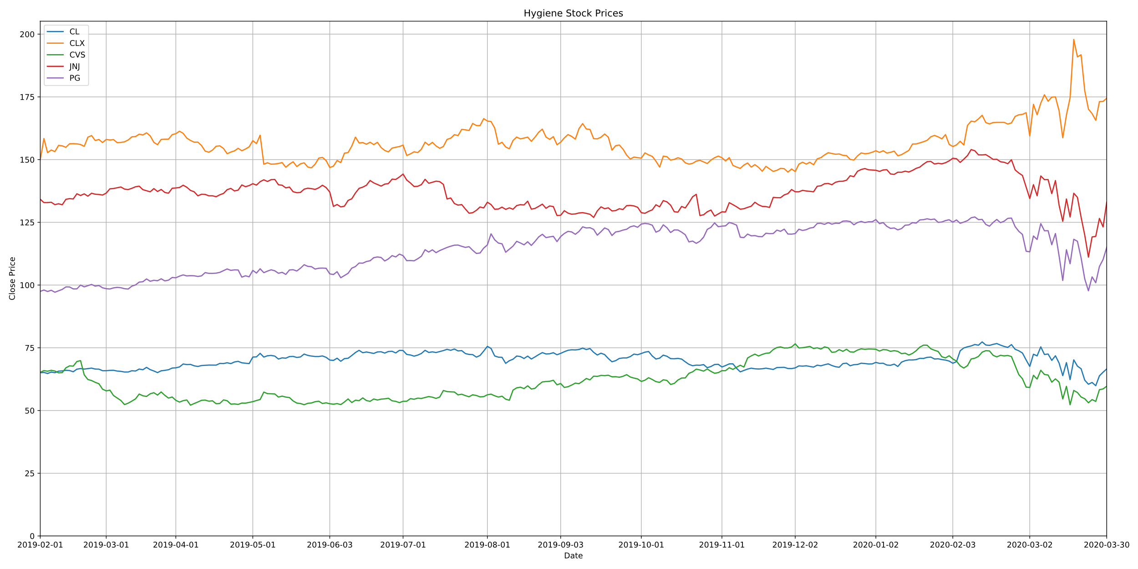
Hygiene Stocks

Slide 5
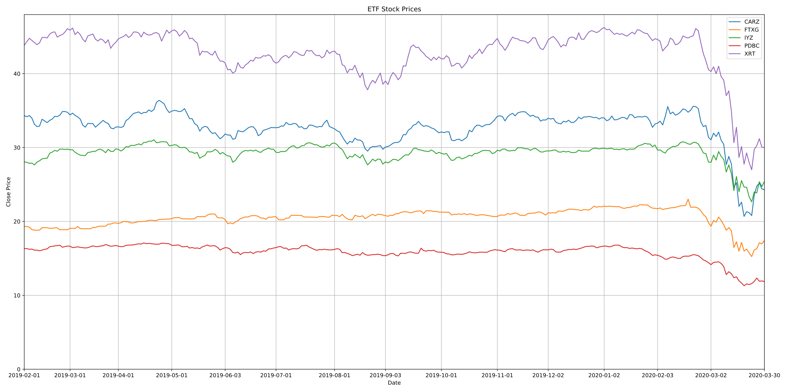
Industry ETFs
CARZ: Car Industry FTXG: Food & Beverage
IYZ: Telecommunications
PDBC: Commodities
XRT: Retail

Slide 6
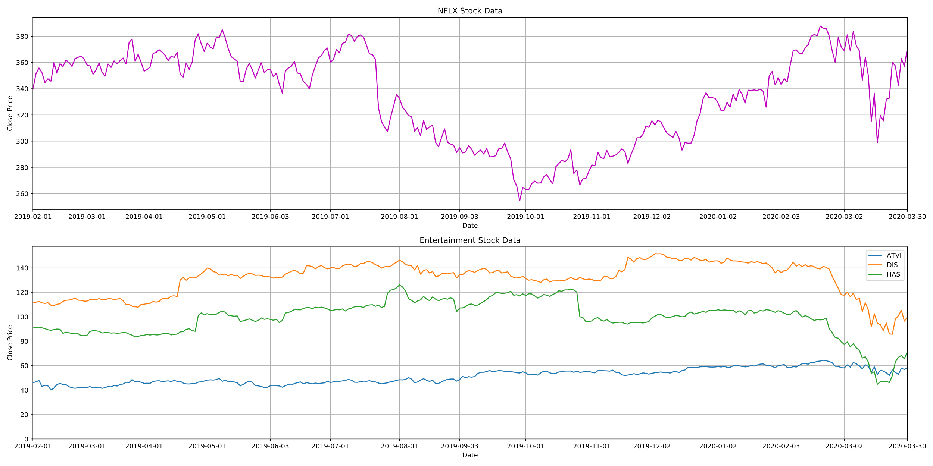
Entertainment Stocks

Slide 7
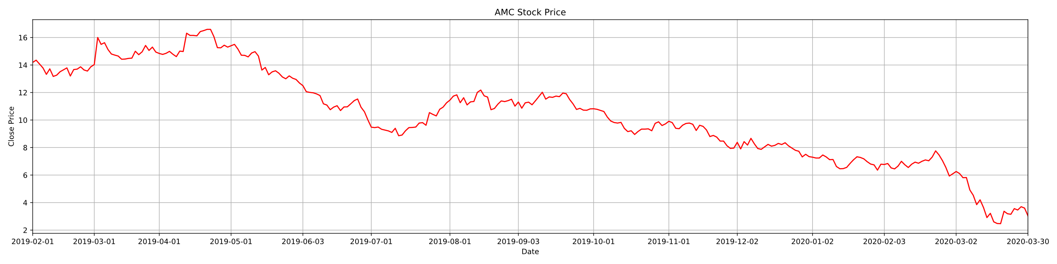
Netflix had a sharp decline, but bounced back quickly
Activision-Blizzard had almost no decline.
AMC went down to almost $2/stock compares to over $14/stock this time last year
Disney hit harder than anticipated given the popularity of Disney Plus

Slide 8
Conclusion
Unsurprisingly, retailers and the car industry took an enormous hit due to COVID-19.
Walmart, however, did not decline as much as anticipated.
Markets not shown behaved as expected, sharp declines mostly in mid March.
Clorox is the only stock we looked at that actually improved due to the pandemic, outperforming competitors.
The entertainment companies as a whole took less of a hit than anticipated.
Limitations
Low sample size
Somewhat limited API
Time

Slide 9
Question 2:
How do the Different Industry Averages Compare to the Market as a Whole during the crash caused by COVID-19?
We examine the sampling of 5 ETFs from different industries and compare them to the DOW Jones Industrial Average and S&P 500 Indexes to see their performance after the 2020 market crash caused by COVID-19. (2/20/20)
We will look at how the ETFs compare to the industrial averages as a whole. Some ETFs performed better than the industrial averages after the crash, and others performed worse.
We are looking at the automobile industry, the Food & Beverage industry, the Telecommunications industry, the Retail industry, and the Commodities industry.
The following slides will show how these ETFs compare to the DOW Jones Industrial Average and S&P 500 Indexes.

Slide 10
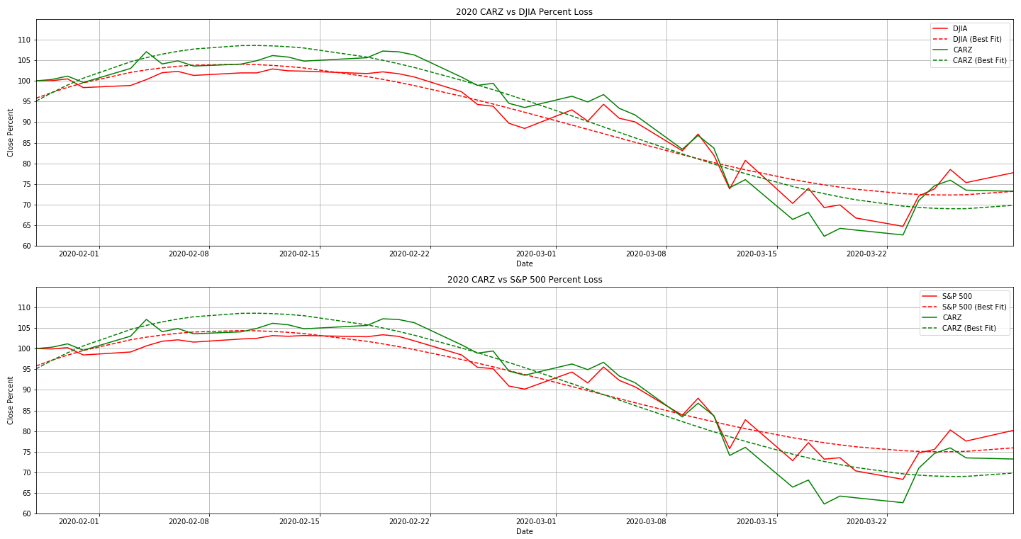
CARZ vs Dow Jones and S&P 500
(Automotive Industry)

Slide 11
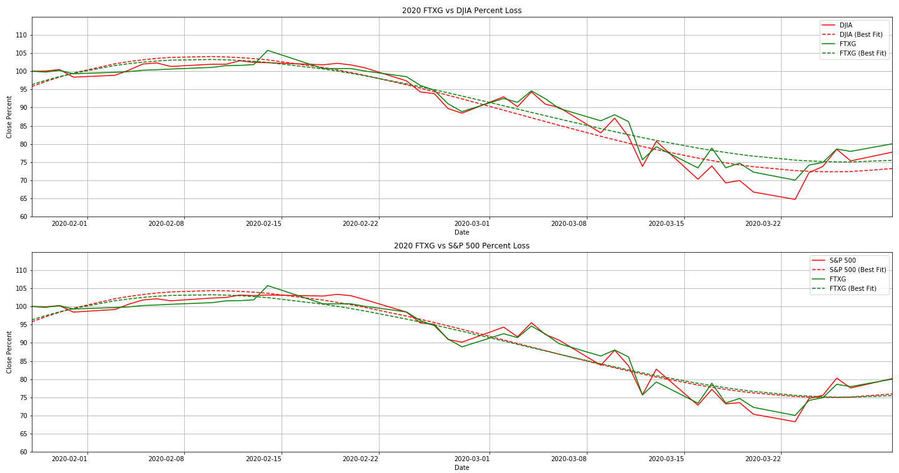
FTXG vs Dow Jones and S&P 500
(Food & Beverage)

Slide 12
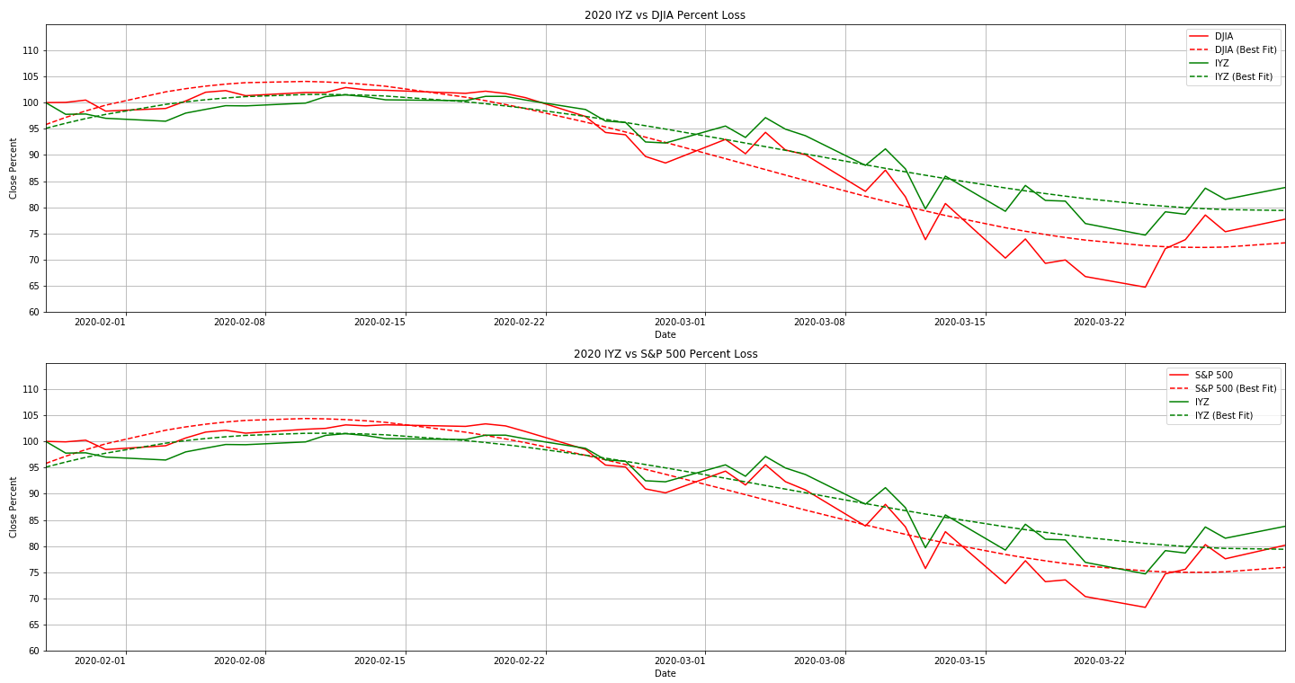
IYZ vs Dow Jones and S&P 500
(Telecommunications)

Slide 13
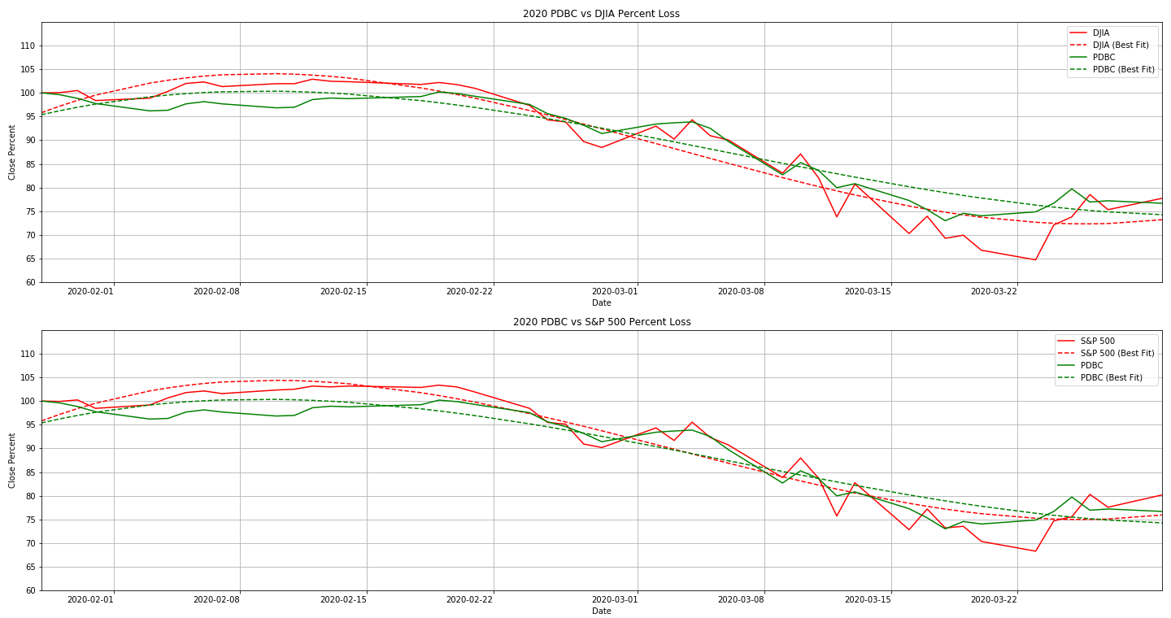
PDBC vs Dow Jones and S&P 500
(Commodities)

Slide 14
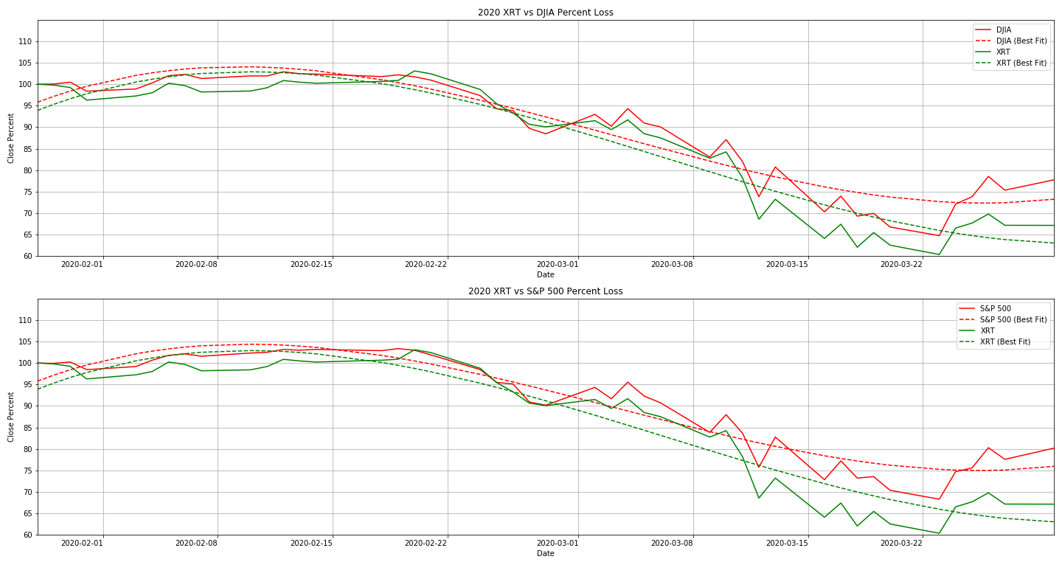
XRT vs Dow Jones and S&P 500
(Retail)

Slide 15
Conclusion
Most markets are performing similarly to the overall indexes.
The Automotive, Food & Beverage, and Commodities Industries/Stocks are performing about the same as the overall market. This isn’t much of a surprise, as some auto manufacturers are retro-fitting equipment to help with the pandemic.
Telecommunications is the only market that has outperformed the market since the crash.
The retail industry has been hit hard. With forced closures of non-essential businesses, and people unable to work, they will be focusing on purchasing only the essentials.
Limitations
Low sample size
Somewhat limited API
Time

Slide 16
Question 3:
How Does the Crash Caused by COVID-19
Compare to the Stock Market Crash of 2008?
* We will first look at the overall time series plots of the 2020 and 2008 crashes for the S&P 500 and the Dow Jones Index in order to represent the market as a whole and how it trended from a month prior to the crashes to a month after the crashes
* Taking the day of the crash as our reference point, we will look at the percentage decrease and increase from the other days as compared to the days of the crashes
* Compare how the 2020 indexes changed vs how the 2008 indexes changed

Slide 17
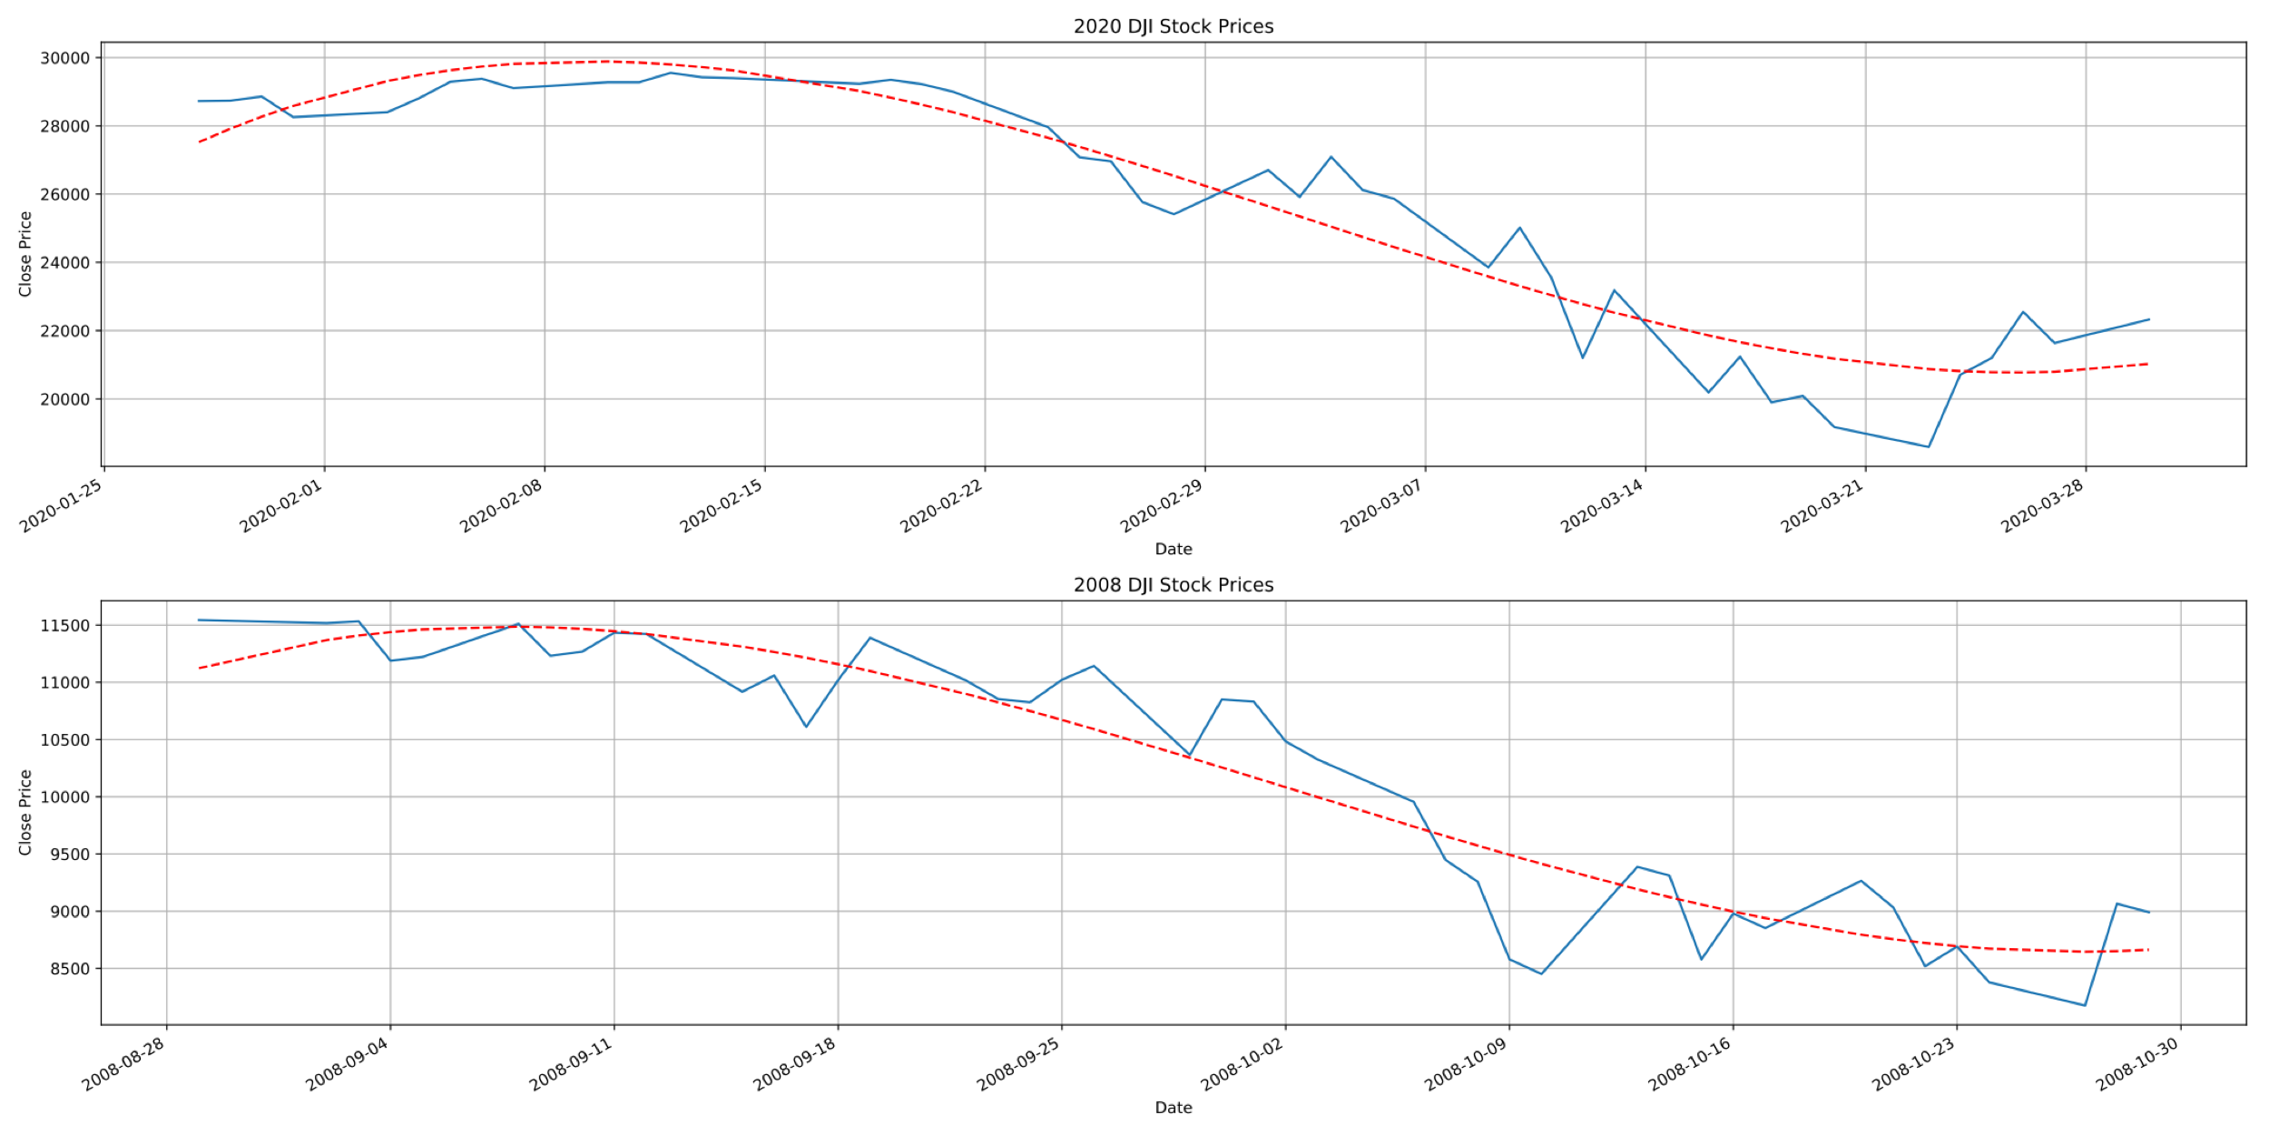
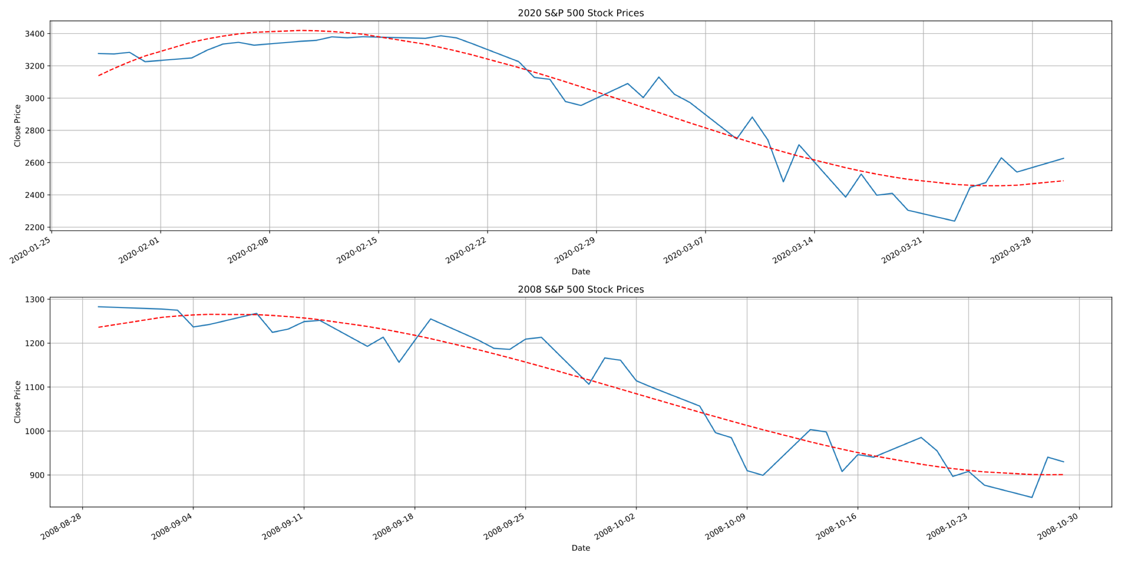
2020 vs 2008 Time Series for DJI and S&P 500

Slide 18
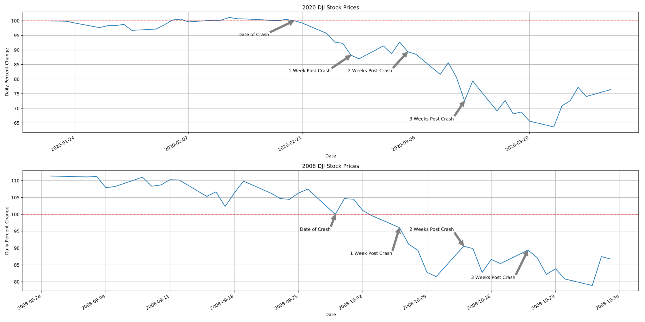
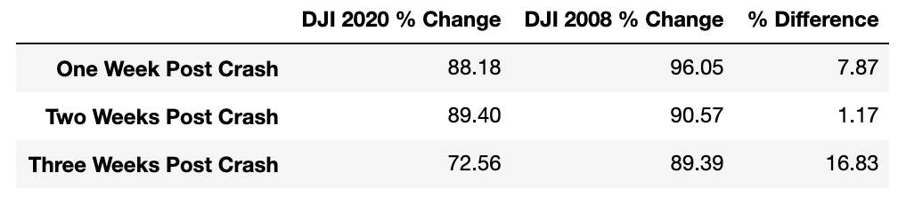
Percent Change Comparison DJI

Slide 19
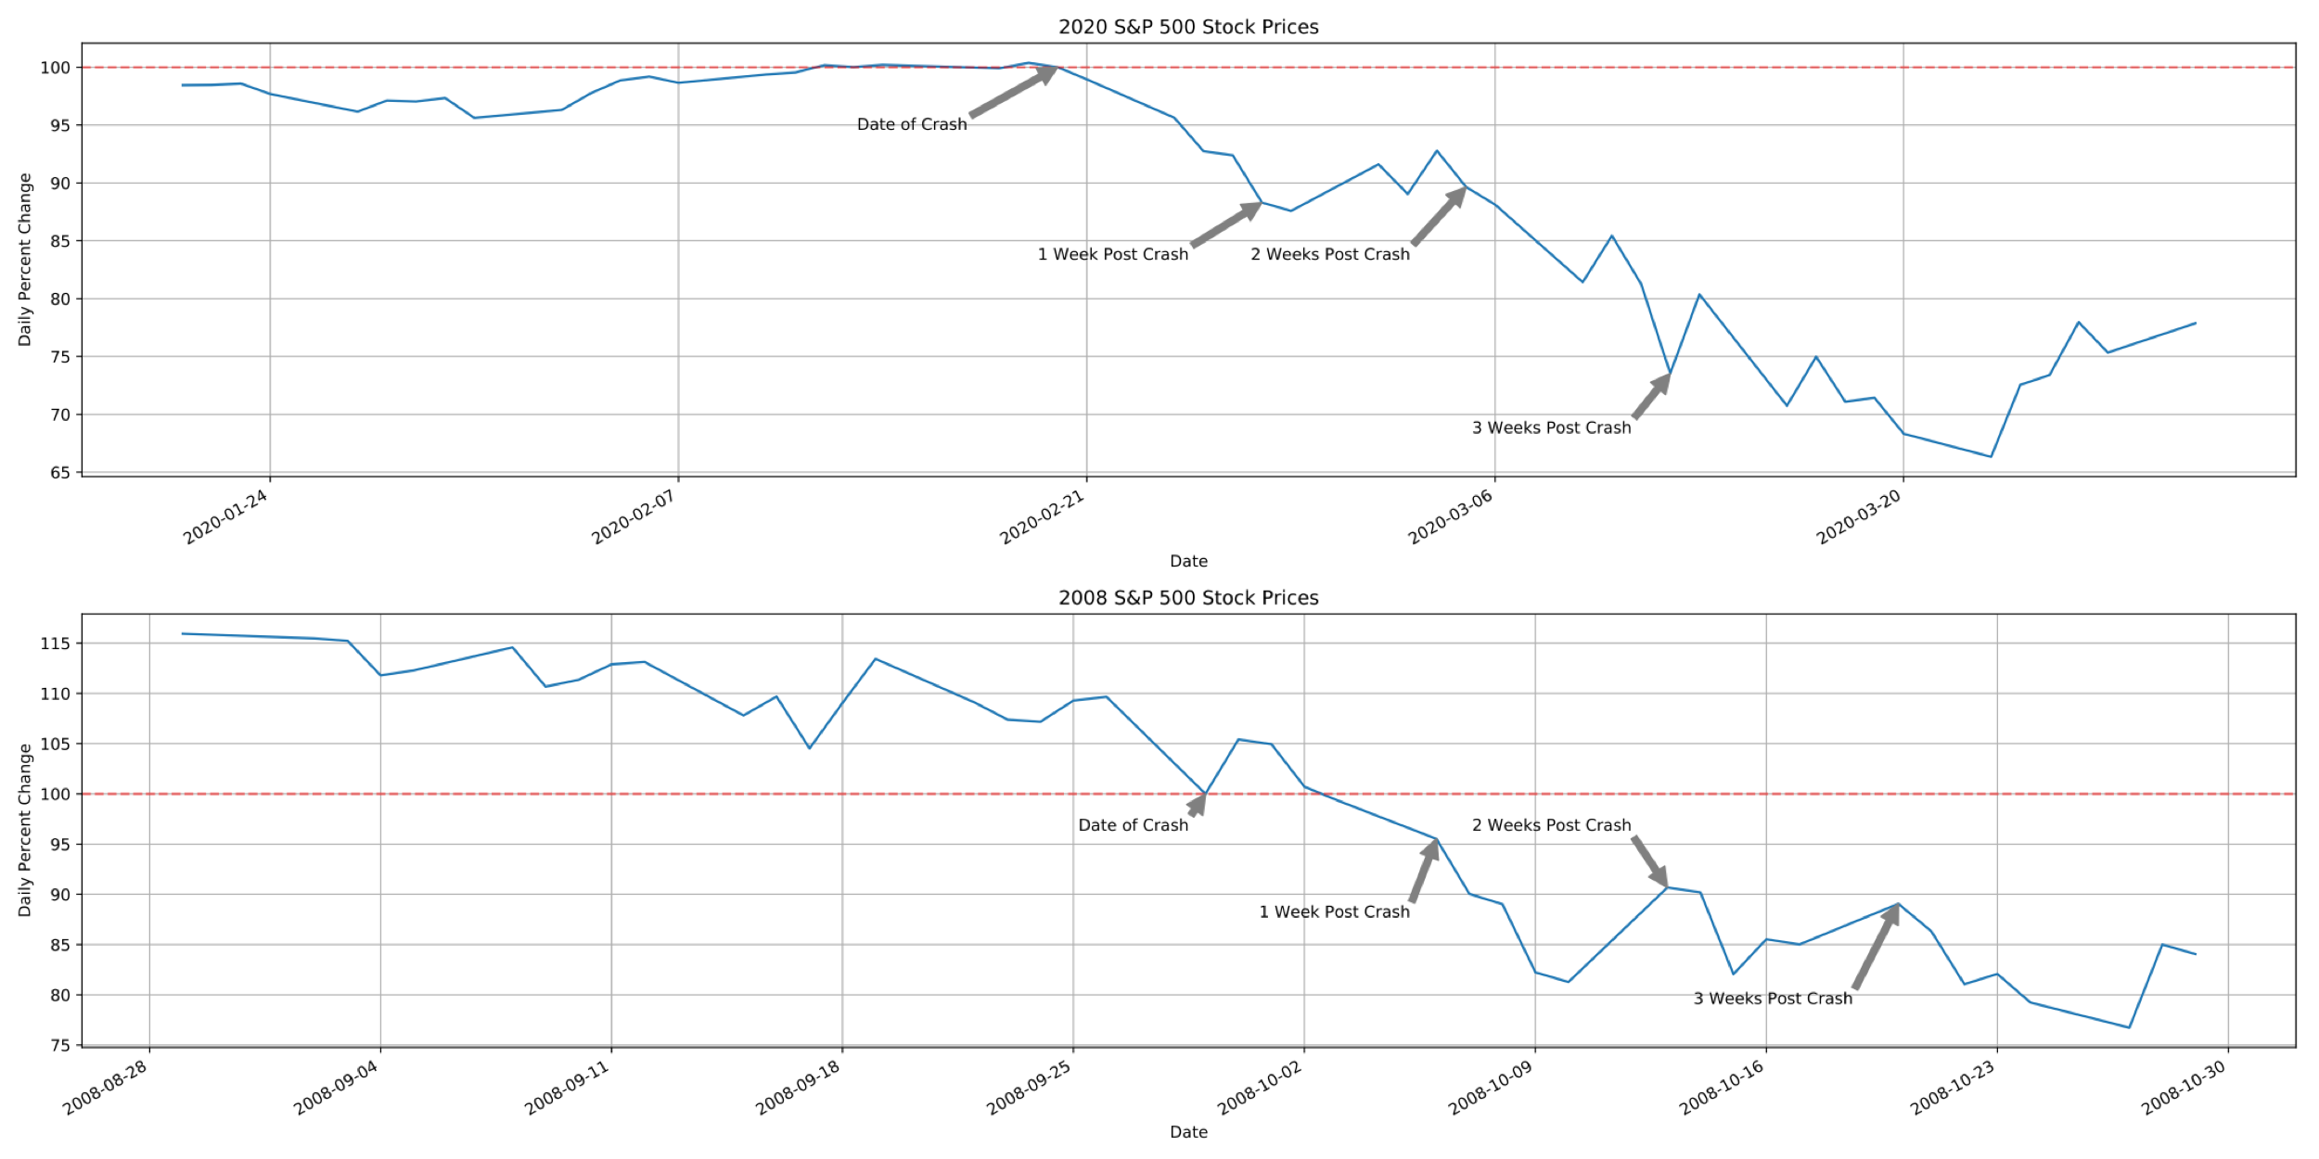
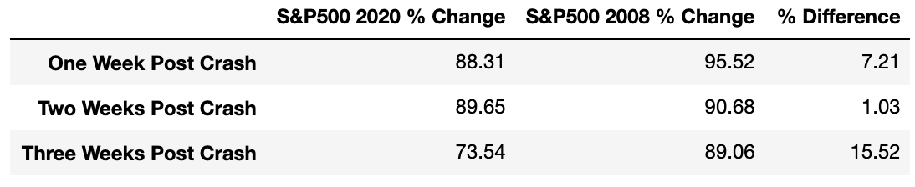
Percent Change Comparison S&P 500

Slide 20
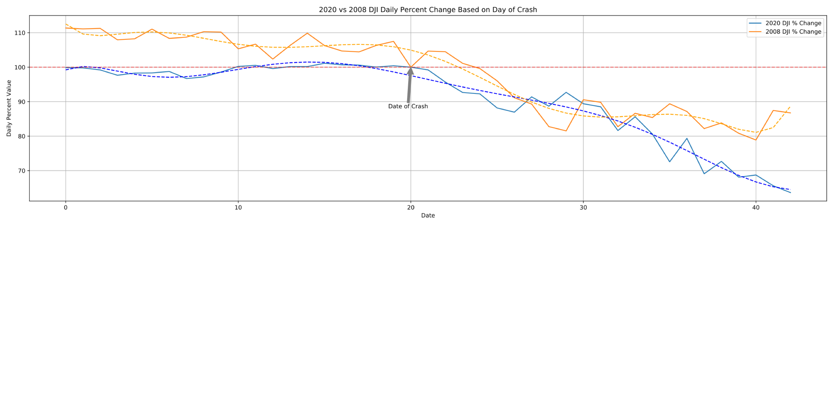
2008 and 2020 date data has been changed to an index value in order to have both crash dates set equal
Follows the same general trend, obviously continuously decreasing over time, however, you can notice as the days since crash increases the 2008 data stabilizes whereas the 2020 data continues to decrease
Shown by the trendlines, the concavity of the two plots oppose one another at roughly 10 days post crash
Notes:
The stock market crash of 2008 occurred on Sept. 29, 2008. The Dow Jones Industrial Average fell 777.68 points in intraday trading.1﻿ Until the stock market crash of 2020, it was the largest point drop in history. 2020 march 9 falls 1300 points

Slide 21
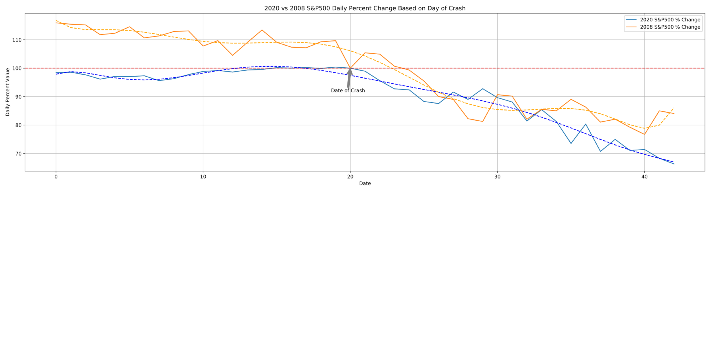
Plotted like that of the Dow Jones Index, we can see the same compared relationships
At roughly 10 days post crash, the 2008 data trendline suggests that the decrease has begun to somewhat stabilize, changing concavity often however decreasing very slightly. The 2020 trendline, however, is still following a linear decline.

Slide 22
Conclusions and Limitations
The general trends of the 2020 index values and percentage drops follow the trends of the 2008 index values and percent drops for days relatively close to crash
Because COVID-19 is still reeking havoc on the world, the markets continue to decline and because there is no real end in sight it is tough to compare this crash to that of 2008, which is why in the previous charts you can see the difference in concavity of the trend lines as the days following the crash continue to increase
Limitations:
Alphantage API does not have access to the NASDAQ index
Compare the index changes of this disaster to other natural disasters
No end in sight for COVID-19

